Slide 1
IBM University Engagement Project Submission
“Exploring the Power of Agentic AI with IBM Granite and IBM Bob”

Slide 2

Project Tile – [SMART STUDY GENERATOR AGENT]
Domain of Project – [Education]
Faculrty Name | Recent Passport Photo | Email ID | Mobile number [WhatsApp]
AYYAGARI PRASADA RAO |  | ayyagariprasadarao@gmail.com | 9985273672
Recommended font style and size:
Font Style: Arial
Font Size (Heading): 28
Font Size (Content): 20

Slide 3
Problem Statement -
The initial Machine Learning Prediction Application failed to run because a critical trained model file was missing. When the application started up, the app.py script attempted to load a serialized model pipeline from models/model.pkl. However, because the train_model.py script had never been executed, the models/ directory was completely empty, causing every page load to crash with a "Model not found" error that halted rendering immediately.
A secondary technical issue compounded this problem: the model loader function load_artefact() was configured with Streamlit's @st.cache_resource decorator without any file-state-aware cache key. Consequently, once Streamlit cached a None result from the missing file, it continued returning None on every subsequent request—even after the model file was successfully generated—until the entire server process was manually restarted.

Slide 4
Proposed Solution -
To resolve these issues, a three-step fix was implemented. First, train_model.py is executed prior to launching the application to automatically detect the dataset, compare multiple machine learning algorithms using cross-validation, select the highest performer (an SVM model achieving 96.67% test accuracy on the Iris dataset), and serialize the pipeline using joblib.
Second, the load_artefact() function in app.py was updated to accept the model file's modification timestamp (os.path.getmtime) as a cache key parameter (_mtime). Streamlit treats any change in arguments as a cache miss, ensuring the model automatically reloads whenever the .pkl file is updated without requiring a manual server restart. Finally, restarting the Streamlit server clears any stale memory states and launches the full prediction user interface successfully.

Slide 5
Technology Used
Core Programming Language:
  Python 3.15 serving as the foundation for the entire application.
Machine Learning & Data Processing:
  scikit-learn: Manages model training, preprocessing pipelines, and cross-validation.
  NumPy: Utilized for high-performance numerical computations.
  Pandas: Handles data loading, manipulation, and feature engineering.
Web Framework & UI:
  Streamlit 1.66.0: Powers the interactive web application widgets, sidebars, and tab navigation.
Model Serialization:
  Joblib: Used for efficient model persistence and saving.
Development Environment & Deployment:
  Local Server: Runs locally on localhost:8501/8502.
  Operating System: Windows 10/11 (x64) deployment platform.
  AI Assistance: IBM Bob used for streamlined code generation and troubleshooting.
Task | Models
Classification | Logistic Regression, Decision Tree, Random Forest, Gradient Boosting, SVM, KNN
Regression | Linear Regression, Ridge, Random Forest, Gradient Boosting, SVR

Slide 6
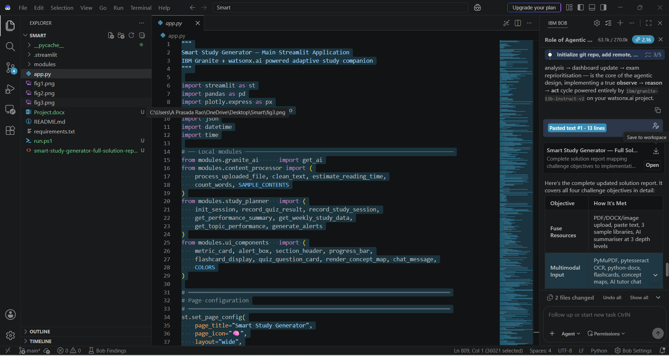
Required Files created using IBM bob -
App.py
Requirements.txt
Style.css
.env
Index.html

Slide 7
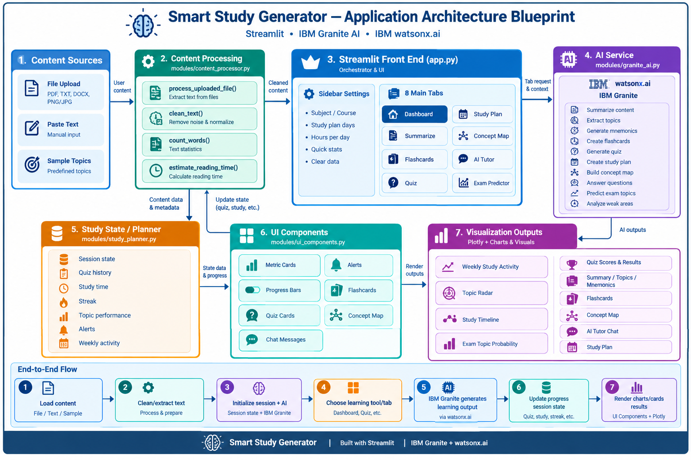
Architecture blueprint for IBM bob:

Slide 8
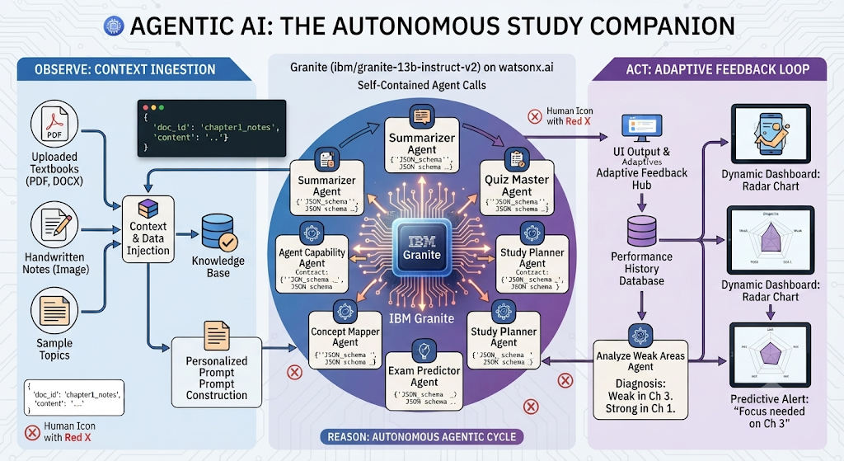
Role of Agentic AI in the solution
The Smart Study Generator leverages IBM Granite (via ibm/granite-13b-instruct-v2 on watsonx.ai) as an autonomous agentic AI that independently executes study tasks. Instead of relying on human curation, the system summarizes raw content, generates flashcards and quizzes, builds multi-day study plans, maps concepts, and predicts exam topics dynamically through self-contained agent calls using structured JSON schema contracts.
Furthermore, the AI is fully context-aware by injecting the student's uploaded textbooks or notes directly into the prompt, grounding responses in personal study material. It drives an adaptive feedback loop: quiz performance history is recorded and analyzed to autonomously diagnose knowledge gaps and strong areas, updating the dashboard radar chart and predictive alerts in real time following an observe-reason-act cycle.

Slide 9
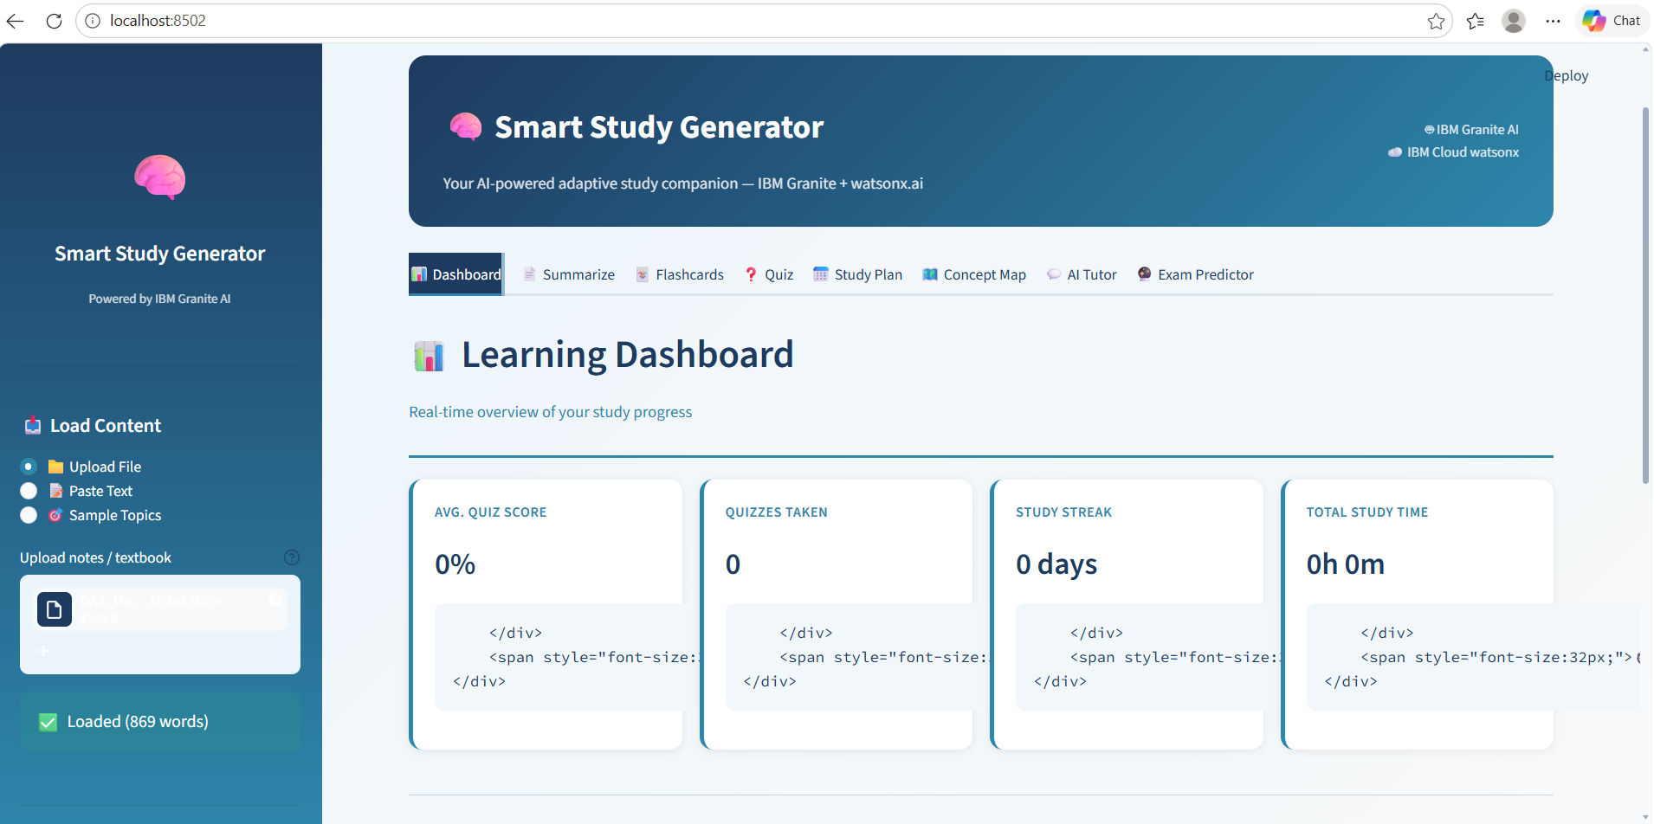
Project Output Screenshot
·
·
·

Slide 10
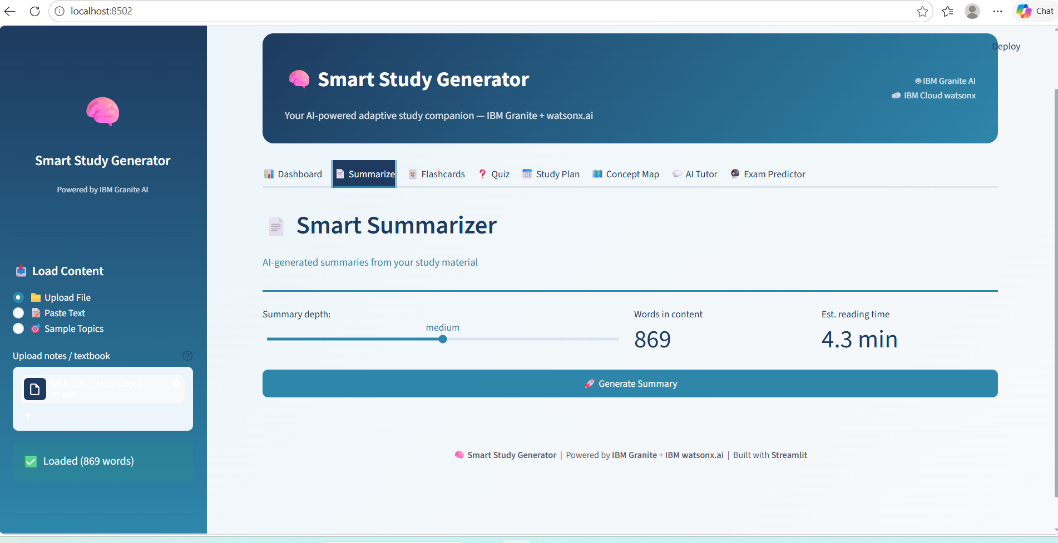
Project Output Screenshot
·
·
·

Slide 11
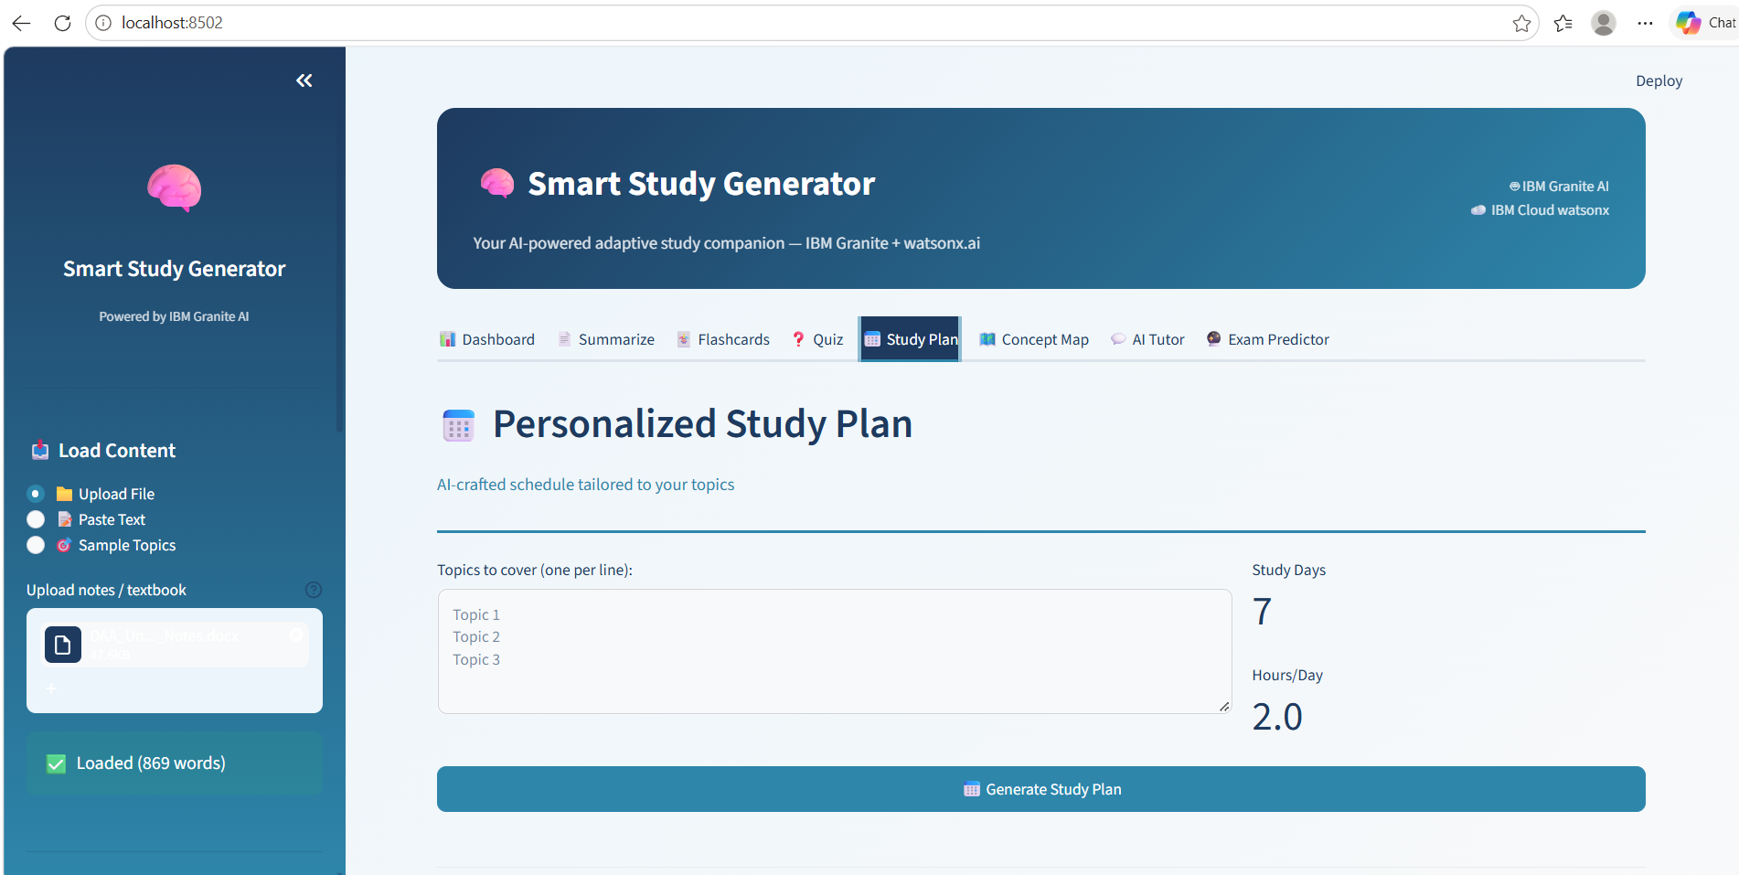
Project Output Screenshot
·
·
·

Slide 12
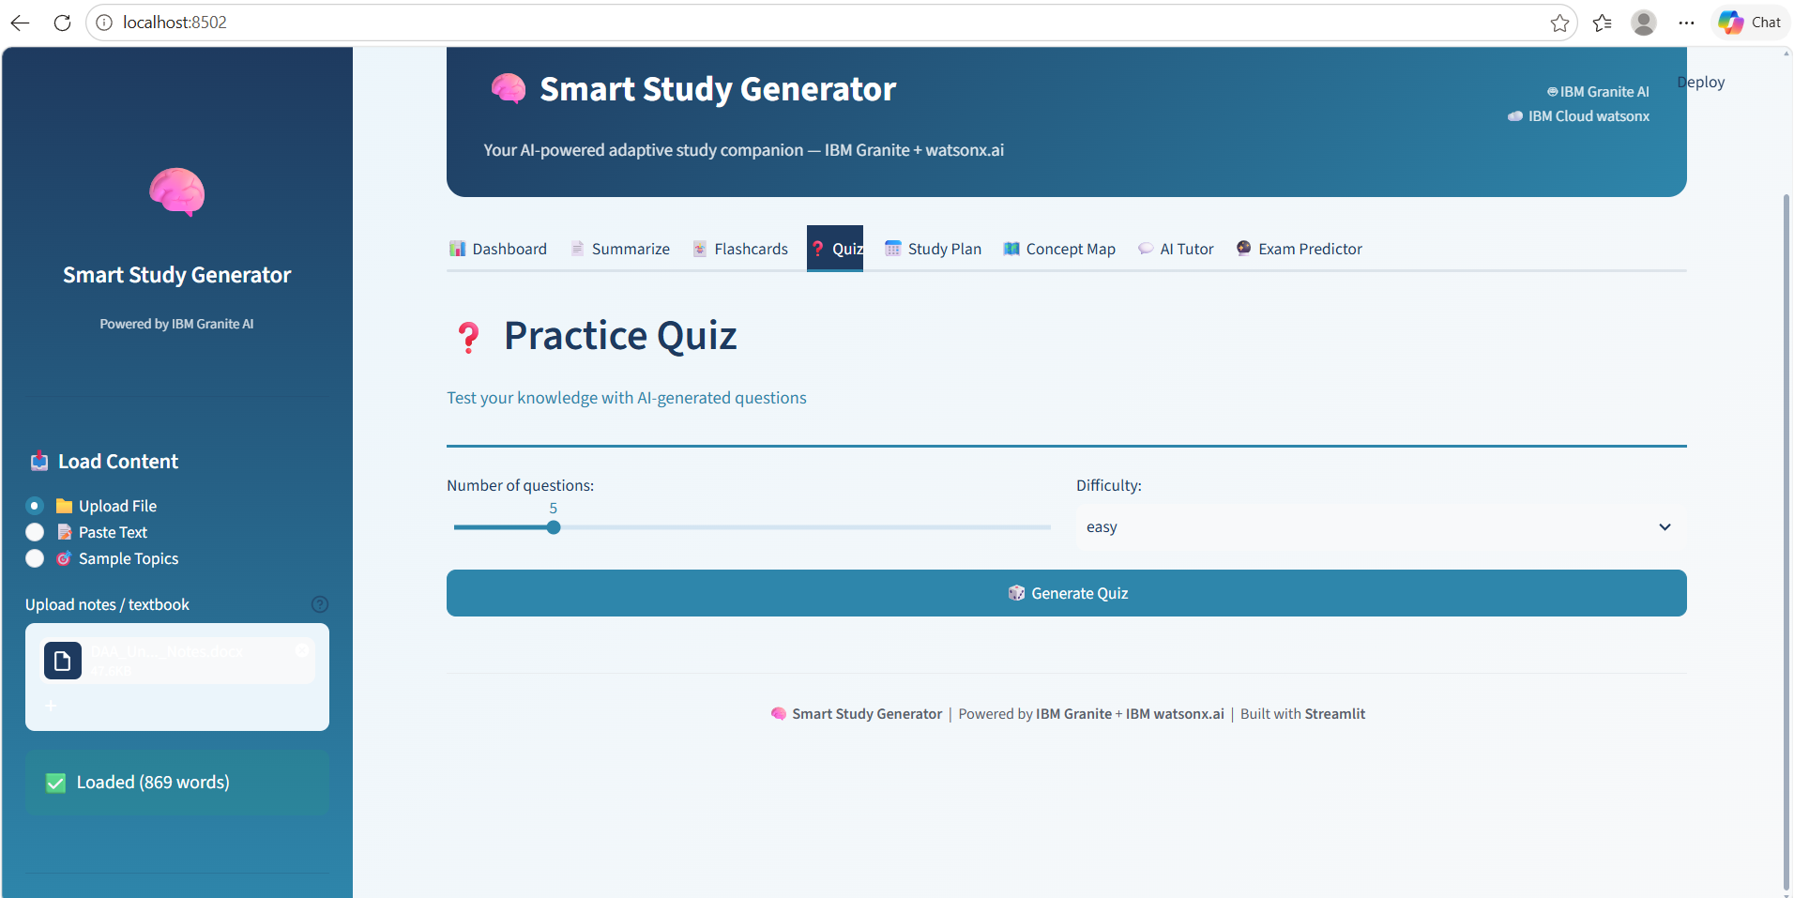
Project Output Screenshot
·
·
·

Slide 13
Novelty and Uniqueness
This application stands apart from conventional study tools because it utilizes a single foundation model—IBM Granite—to simultaneously act as a summarizer, quiz master, concept mapper, exam predictor, mnemonic generator, and personal tutor. Every feature is driven by the same model receiving schema-enforced prompts, eliminating the need for separate specialized models or rigid rule-based engines.
What makes the solution uniquely novel is its self-closing adaptive feedback loop and graceful offline fallback via _fallback_response(). Quiz results automatically reshape future study focus, progressively shifting attention toward weak areas without manual teacher input. Combined with personalized context injection from uploaded documents, this creates an intelligent system that continuously learns alongside the student.

Slide 14
Git Hub Link
· Please create public github repository (Enable Add README button while creating repository) with format –
Please test and Paste the working Github URL –
Make sure you have Uploaded following three files into your github repository
1) All Agent relevant files of IBM Cloud , 2) yourproblemstatement.pdf file 3) your projectpresntation.pptx file 4)any other files
·
·
·

Slide 15
Future Scope
The Smart Study Generator has significant potential for expansion in the area of multi-modal and collaborative learning. Currently, the system processes text extracted from PDFs, DOCX, and images, but future versions could integrate richer multi-modal understanding — allowing IBM Granite to reason directly over handwritten lecture notes, diagrams, mathematical equations, and even audio recordings of lectures. A collaborative layer could enable multiple students to share concept maps, quiz decks, and study plans in real time, turning the tool from a solo companion into a team-based learning platform. Integration with Learning Management Systems (LMS) such as Moodle or Canvas would allow automatic ingestion of course syllabi, deadlines, and graded assignments, letting the AI build study plans that are anchored to real academic calendars and weighted by actual exam schedules.
On the AI intelligence frontier, the system is well-positioned to evolve from reactive generation to proactive mentorship. Future iterations could incorporate spaced-repetition algorithms (like the SM-2 algorithm used by Anki) directly into the flashcard engine, scheduling card reviews at optimal memory-retention intervals based on each student's flip history. The analyze_weak_areas() feedback loop could be deepened with long-term memory persistence — storing performance data across sessions in a vector database — so the AI tracks learning trajectories over weeks and semesters, not just a single session. Additionally, integrating IBM watsonx.ai's newer Granite 3.x models with function-calling and tool-use capabilities would enable the agent to autonomously browse reference material, cross-check facts, and even generate citations — elevating the system from a study aid into a full AI-powered academic research and learning assistant.
·
·
·

Slide 16
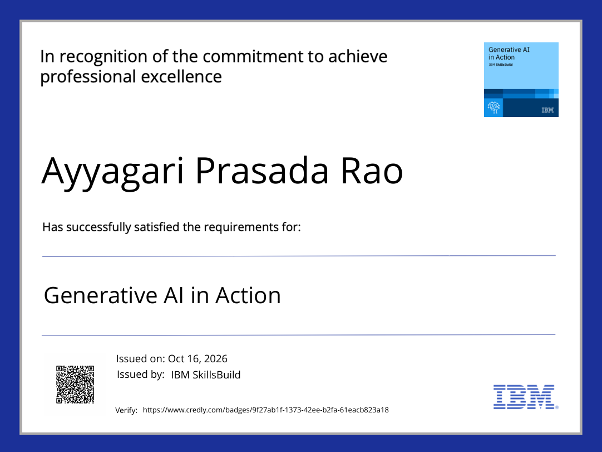
Certificates Earned:

Slide 17
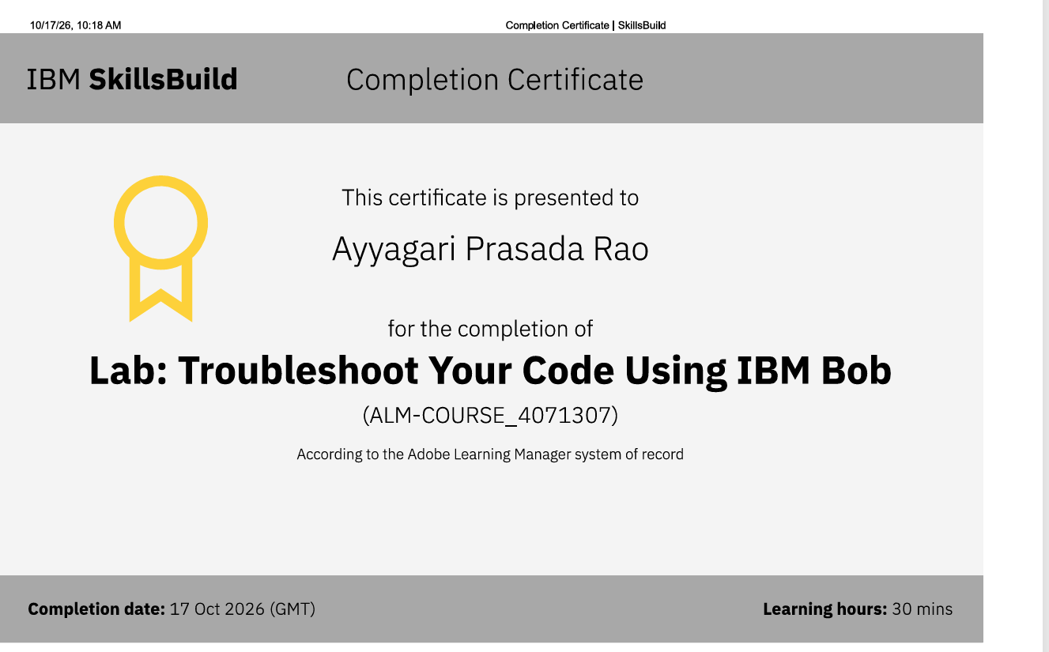
Certificates Earned:​

Slide 18


